Slide 1
Outlier Detection in Stream Data by Clustering
Dr. Abbas Najafizadeh
Heydar Mahmoodi
Data mining

Slide 2
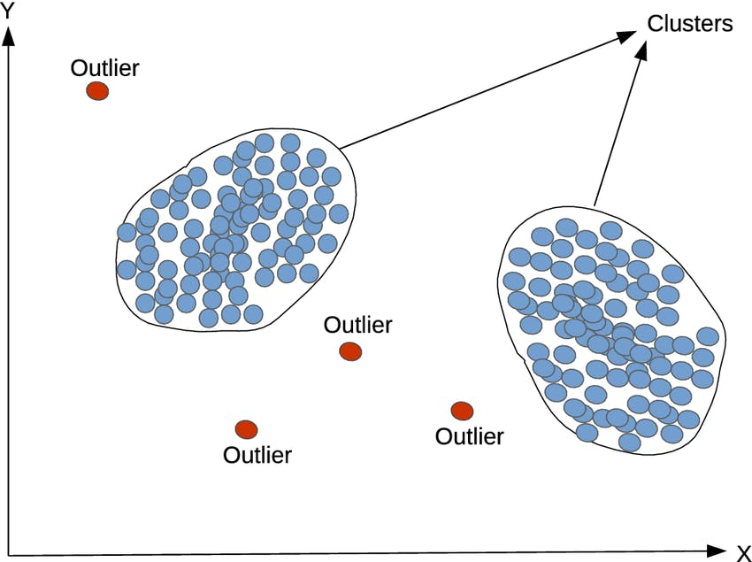
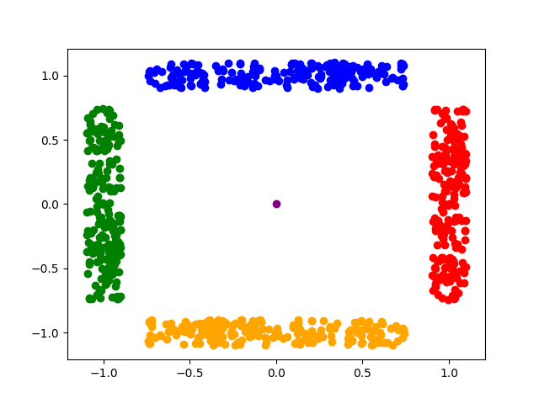
Introduce
Exploring real-time anomaly detection through clustering methods in streaming data.

Slide 3
Where?
weather forecast information
monitoring information for network media transmission
sensor transfer information in coal mines
access to website information
economic information produced by finance and securities companies
Fraudulent Financial Transactions Detection
agricultural, engineering control and so on

Slide 4
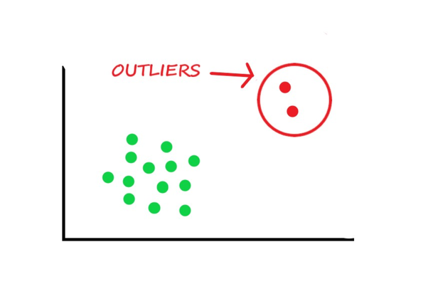
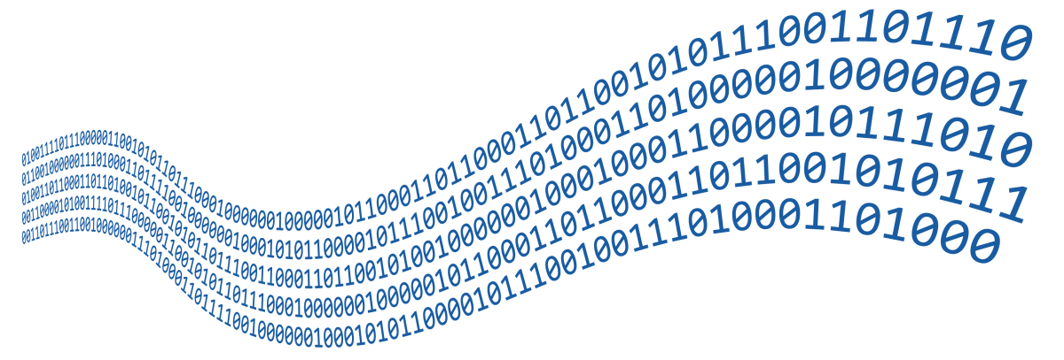
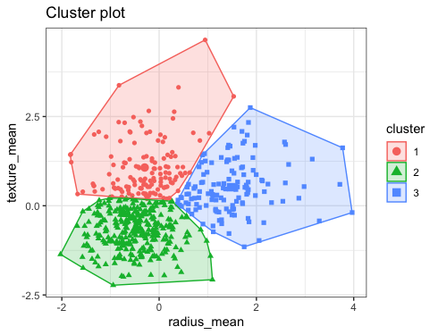
Case study
Outlier Detection
Stream Data
Clustering

Slide 5
Why?
In view of the characteristic of the high dimension, dynamic, real-time, many effective data stream clustering algorithms have been proposed
In addition, data stream information are not deterministic and always exist outliers and contain noises, so developing effective data stream clustering algorithm is crucial
Because of this form of data is massive and updated in real time, traditional clustering methods cannot be used to process it.

Slide 6
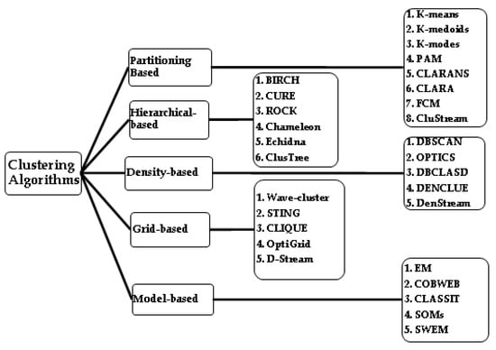
Overall

Slide 7
Which method?
Data Characteristics: the data may be something that we cant use in our methods.
Cluster Shape: For non-spherical clusters, density-based or hierarchical methods might be better.
Scalability: Partitioning methods like K-Means are more scalable for larger datasets.
Interpretability: Hierarchical clustering provides an insightful dendrogram.

Slide 8

TraditionalData(static)
Static and stable
Accessed at any time
Processed more than once

Slide 9
Stream Data (dynamic)
Compared with traditional data forms, data stream has its own characteristics.
dynamic and it flows like a stream (sequential and changes over time)
Real-time , continuous , ordered (large amount of data , potentially unlimited , arrival rate uncertain)

Slide 11
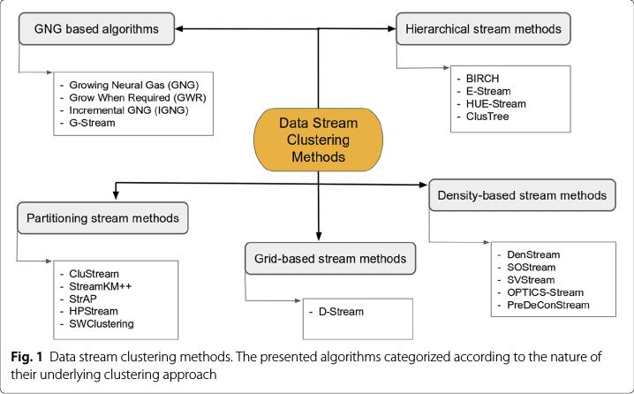

Slide 12
DBSCAN
Pros:
Robust to outliers: Can identify outliers as noise points.
Handles arbitrary-shaped clusters: Not limited to spherical clusters.
No need K: It does not require the number of clusters to be specified in advance.
Cons:
Parameter-sensitive: Requires setting parameters like epsilon and minPoints, which can impact results.
Difficulty with varying densities: Struggles when clusters have significantly different densities.
high computational cost: It has a high computational cost when the number of data points is large.

Slide 13
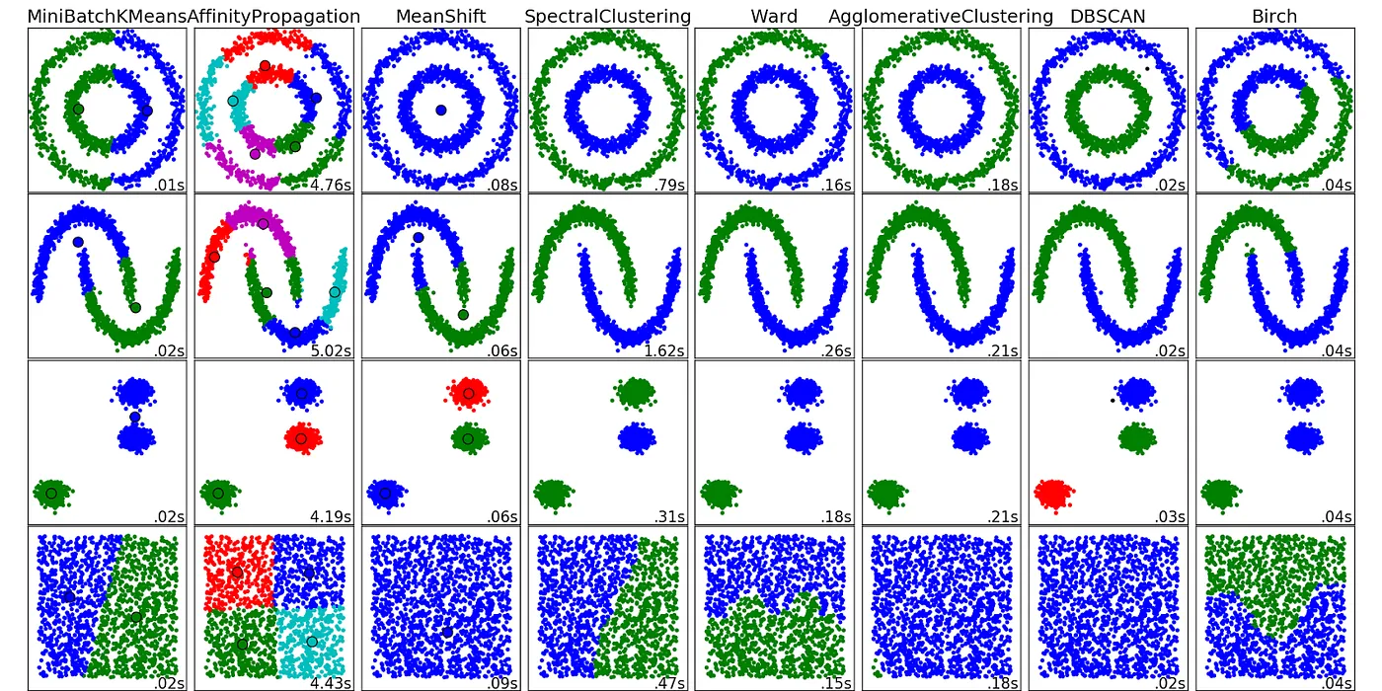
DBSCAN vs …

Slide 14
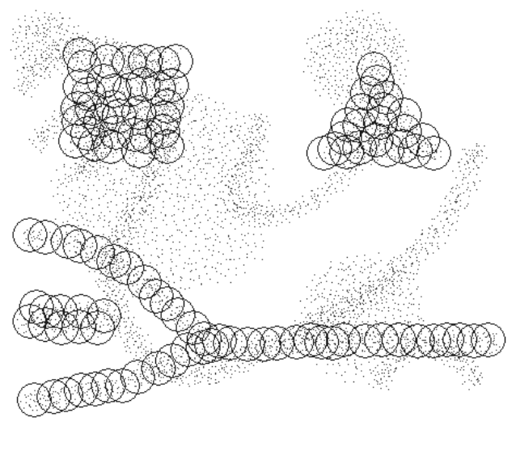
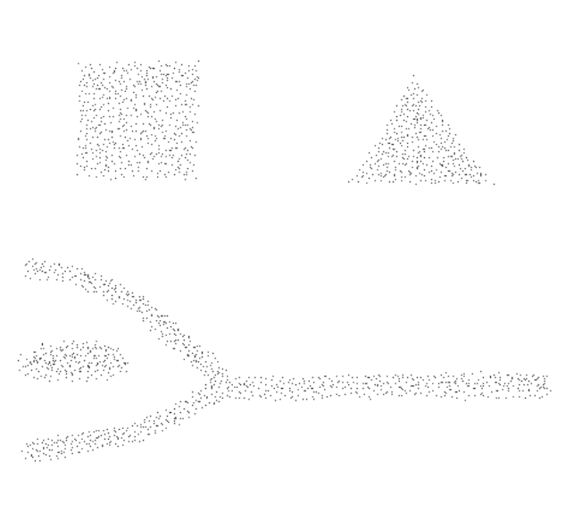
DenStream
Density-Based Clustering over an Evolving Data Stream with Noise
10.1137/1.9781611972764.29 , researchgate link

Slide 15
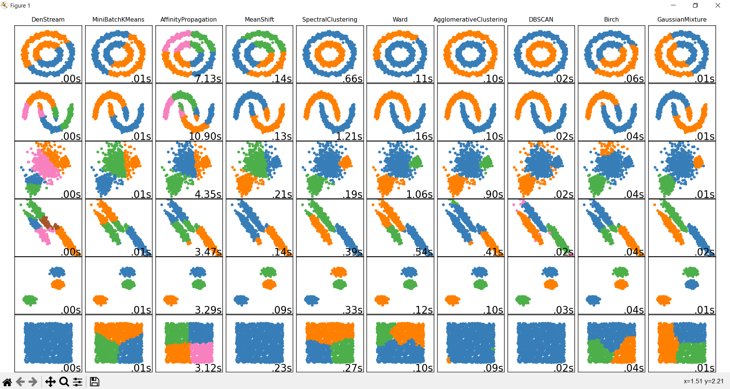
Comparing DenStream(https://github.com/SC-One/DenStream)

Slide 16
DenStream Algo
Initialization
Initialize parameters (epsilon, lambda, beta , and mu) for density calculations and cluster formation.
Microcluster Initialization:
Start with the first few data points as microclusters.
Update the parameters based on incoming data points.
Microcluster Evolution:
For incoming data points:
Update existing microclusters or create new ones.
Use decay function to handle aging of microclusters.
Cluster Formation:
Identify core-microclusters based on density and relevance parameters.
Form clusters using the identified core-microclusters.
Outlier Detection:
Identify outliers based on their deviation from core-microclusters.
Model Adaptation:
Continuously adjust model parameters based on the evolving data.

Slide 17
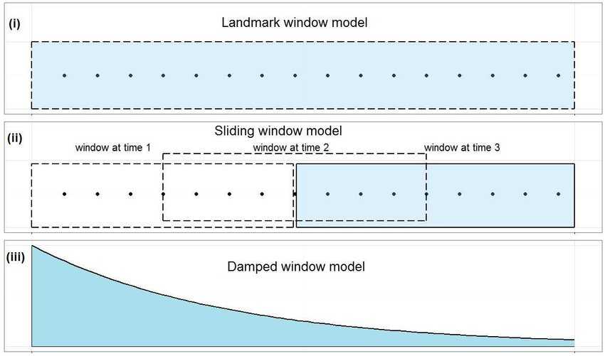

DenStream Algo(cont…)
DenStream using
Damped Window:
Fading function:
$f\left(t\right)=2^{ −λ.t}$ , where: $λ$ > 0

Slide 18
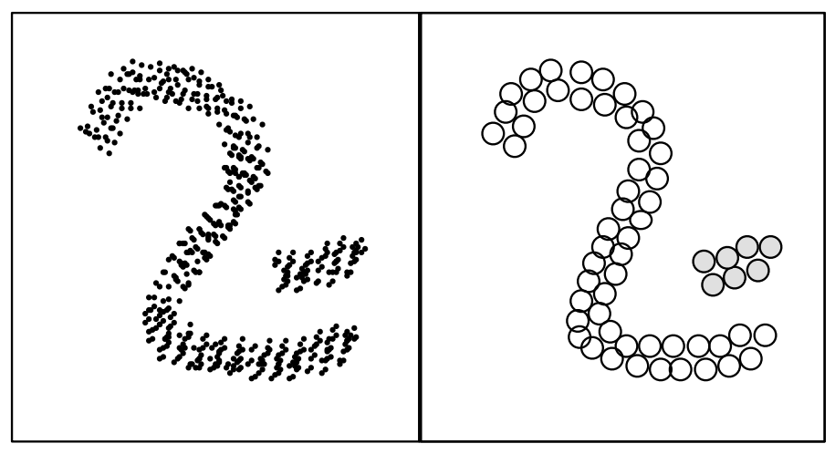
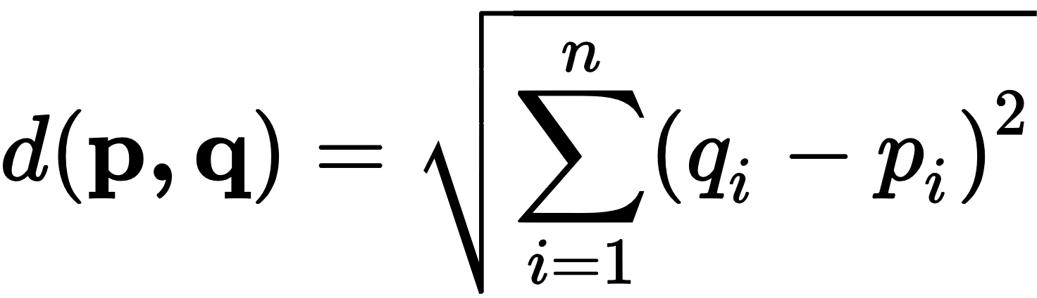

DenStream Algo(cont…)
CMC(core-micro-clusters):
$w= \sum_{j=1}^{n}{f(t−T_{i_{j}})}$ , where T is timestamp of each point
Euclidean distance between point pij and the center:

Slide 19
DenStream Algo(cont…)
In an evolving data stream, the role of clusters and outliers often exchange, and any c-micro-cluster is formed gradually as the data stream proceeds. Therefore, we introduce the structures of potential c-microclusters and outlier-micro-clusters for incremental computation.
PMC(Potential-micro-clusters):
Condition: w ≥ βµ , where : µ is overall weight of data points
Where: 0 < β ≤ 1

Slide 20
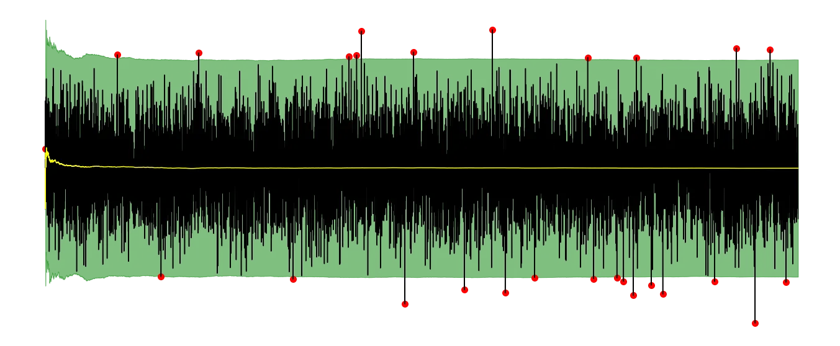
DenStream Algo(cont…)
OMC(outlier-micro-clusters):
w < βµ
Where: 0 < β ≤ 1

Slide 21
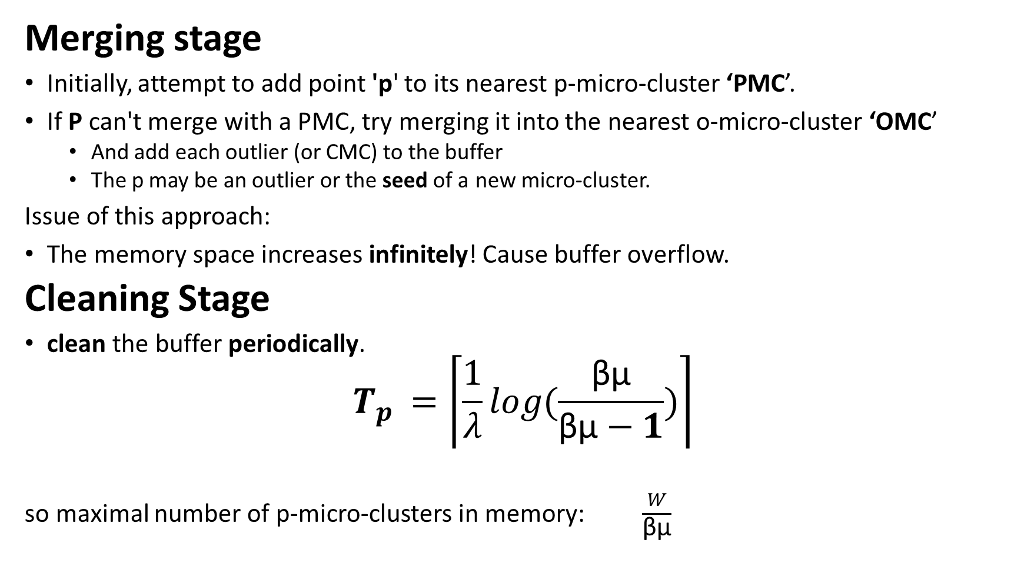
DenStream Algo(cont…)
Merging stage
Initially, attempt to add point 'p' to its nearest p-micro-cluster ‘PMC’.
If P can't merge with a PMC, try merging it into the nearest o-micro-cluster ‘OMC’
And add each outlier (or CMC) to the buffer
The p may be an outlier or the seed of a new micro-cluster.
Issue of this approach:
The memory space increases infinitely! Cause buffer overflow.
Cleaning Stage
clean the buffer periodically.
$$T_{p^{ }}=\left\lceil \frac{1}{λ}\right.\left.log(\frac{\text{β}\text{µ}}{\text{β}\text{µ}−1})\right\rceil$$
so maximal number of p-micro-clusters in memory: $\frac{W}{\text{β}\text{µ}}$

Slide 22
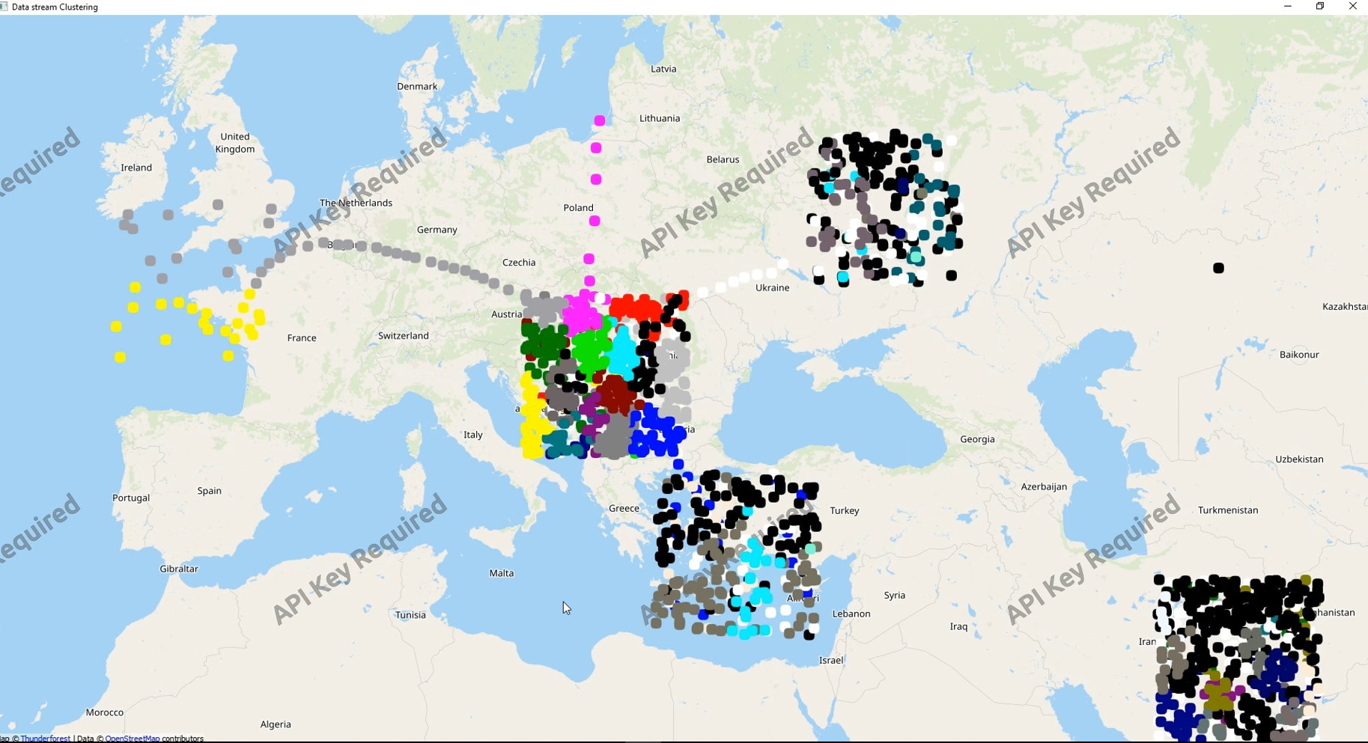
DenStream on location data stream
https://github.com/SC-One/ClusteringDataStream

Slide 23
DenStream conclusion
Pros
No assumption on the number of clusters
Discovery of clusters with arbitrary shape
Ability to handle outliers
Acceptable accuracy in streams
Cons
Sensitive to Parameters (Initial Overhead)
Complexity in Interpretation
Offline & Online stages

Slide 24
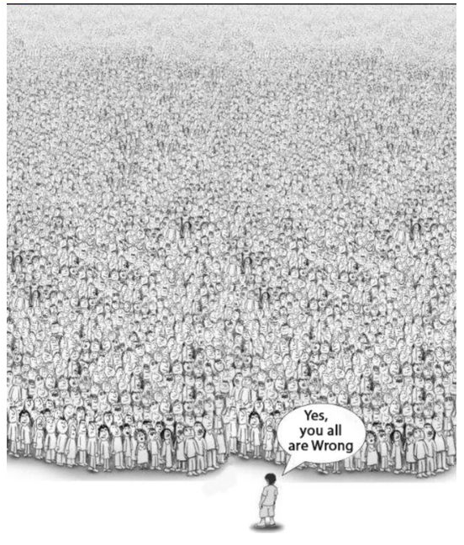

Future

Slide 25
Refrences
https://www.sciencedirect.com/science/article/abs/pii/S0167739X19312786
https://www.researchgate.net/figure/Overview-of-the-proposed-two-step-clustering-method-The-first-step-uses-Birch-clustering_fig4_357972949https://www.oreilly.com/library/view/data-mining-and/9781118868706/9781118868706c21.xhtml
https://scikit-learn.org/stable/modules/generated/sklearn.cluster.Birch.html
https://www.geeksforgeeks.org/ml-birch-clustering/
https://en.wikipedia.org/wiki/Data_stream_clustering
https://medium.com/@noel.cs21/balanced-iterative-reducing-and-clustering-using-heirachies-birch-5680adffaa58https://www.youtube.com/watch?v=YWcDgX_pN-8
https://www.youtube.com/watch?v=A4MzbYc4yCY
https://www.sciencedirect.com/science/article/abs/pii/S0167739X19312786
https://doi.org/10.1016/j.future.2020.01.017
https://www.logsign.com/blog/data-stream-clustering-methods-examples
https://arxiv.org/abs/2210.08212
https://github.com/dple/awesome-papers-and-source-code-for-anomaly-detection
https://www.iwrr.ir/article_87950.html
https://www.sid.ir/paper/159026/fa
https://smartinsight.ir/%D8%B1%D9%88%D8%B4-%D9%87%D8%A7%DB%8C-%D8%AF%D8%A7%D8%AF%D9%87-%DA%A9%D8%A7%D9%88%DB%8C/
https://science.ut.ac.ir/documents/84413665/110319729/kord-asabi.pdf
https://www.geeksforgeeks.org/clustering-in-data-mining
https://www.geeksforgeeks.org/data-mining-cluster-analysis/
https://blogs.sap.com/2020/12/16/outlier-detection-by-clustering/

Slide 26
Refrences(cont...)
https://dl.acm.org/doi/10.1145/1557019.1557041
https://dl.acm.org/action/downloadSupplement?doi=10.1145%2F1557019.1557041&file=p139-bifet_nemeds_01.mp4
https://python.plainenglish.io/how-does-the-dbscan-algorithm-work-pros-and-cons-of-dbscan-bbdd589d837a
https://dzone.com/articles/data-streaming-in-osgi-r7-applications-with-osgi-r
https://cs.stackexchange.com/questions/79429/what-is-the-best-stream-data-clustering-algorithm-that-can-handle-non-static-un
https://erproof.com/sap-prepares-for-a-database-push/
https://towardsdatascience.com/easy-outlier-detection-in-data-streams-3089bfefe528

